Slide 1



Avoid falling –
Avoid Column Femora's Fracture

Slide 2
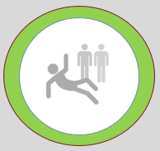
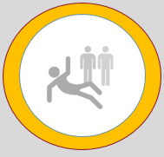
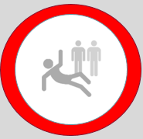
Age 65
Age 72
Age 80
1out 3 falls each year
Fall every 2 year.
Fall every year..

Slide 3
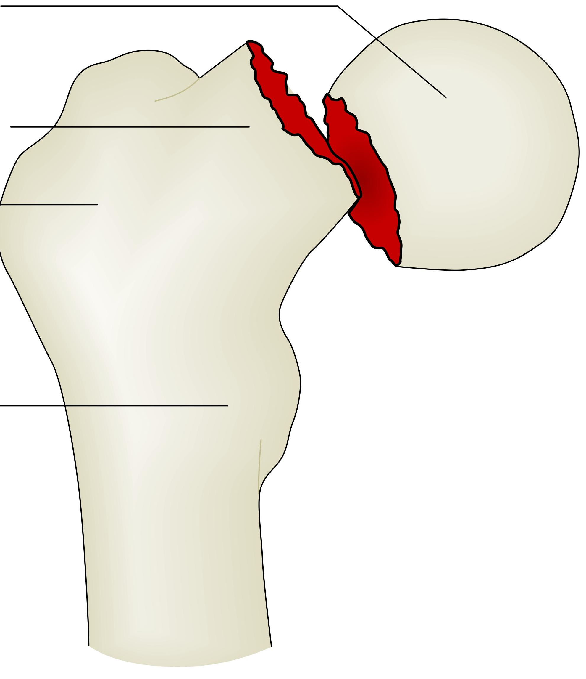
To fall –
Collum Femoris Fractura
For about 1 out of 3
A hip fracture after falling -
it is the start
of a much faster end of life.
In industrialized countries, risk during life to have a Collum femoris fractures is
18% in women
&
6% in men

Slide 4


Denmark is as an example of many welfare societies where , Perhaps even the best society together with other Nordic countries to retire and become a pensioner.
You are set free when you retire and become a pensioner. Most people have a quit strong financial situation, due to your financial support by state pensions and the state support for many costs related to the life as senior citizen.
In Romania as an example representing many countries – the financial situation in senior life – is different from Denmark. Many have to supply their state pension – by being active to make more money.

Slide 5

10.000 Column femora's fracture per year means approximately 600 per 100.000 inhabitants.
Only approximately 200 per 100.000 seniors in Romania will face a fracture..

Slide 6
A recent research in Denmark – showed that this gentlemen still playing football – had the strongest boneconstruction of all the senior citisens investigated in the research.
Football gives many bumps up into the legs – running around.
Remembering the 8 focus point – football stimulate, train and maintain many of the 8 areas of focus presented some slides ago
Balance
Condition ( if they sometimes run 80% of their maximum)
Strength in muscles stretching the legs.
Train the heart – Blood pressure.
BUT WE DON`T NEED TO PLAY FOOTBALL TO MAINTAIN OUR PHYSICAL STRENGTH IN AGEING LIFE.

Slide 7

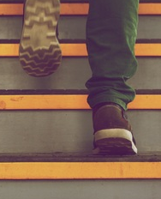
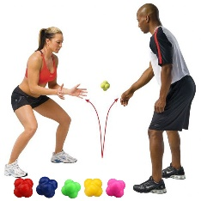
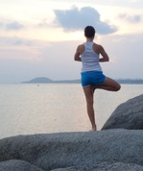
4 factors involved in falling.
Bad not regulated sight
Losing Muclespower
Reduced abilty to react fast
Losing competence of Balance
We fall

Slide 8
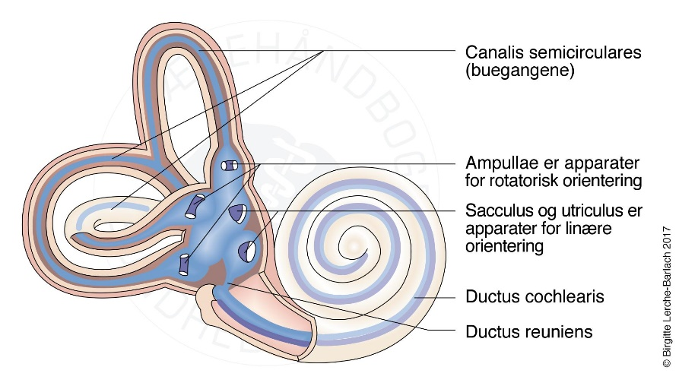
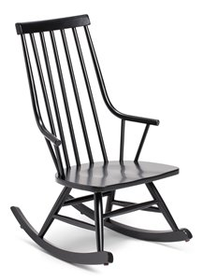
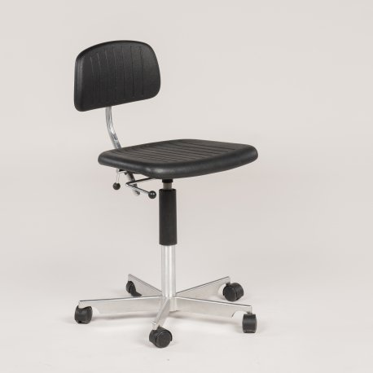
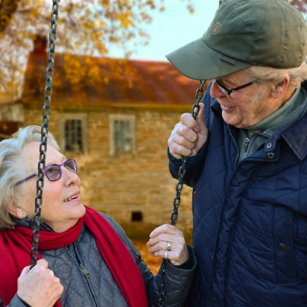
To understand balance
VESTIBULAR SENSE

Slide 9
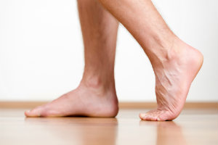
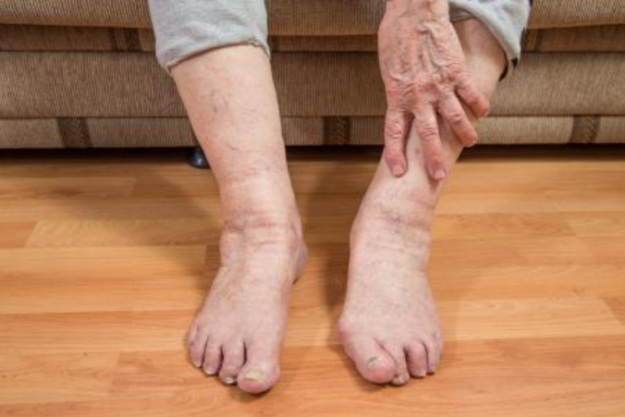
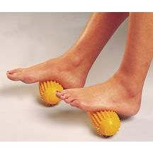
To understand balance
SENSES IN OUR FEET

Slide 10
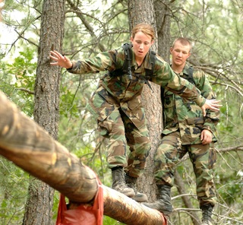
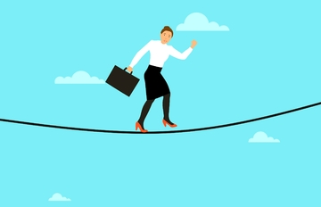
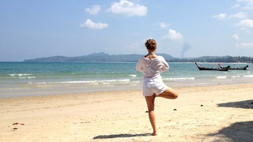
To understand balance
MUSCLES & JOINTS

Slide 11

To understand balance
ABILITY TO REACT & CORRECTING QUICKLY

Slide 12
WHAT TO DO TO AVOID – REDUCE RISK OF FALLING
3 x weekly strength and balance training.
Combined with
A walk 2 times a week.
Prevent fall and fall damage with up to
52%
Even bigger effect at seniors older than +80

Slide 13


